Slide 1

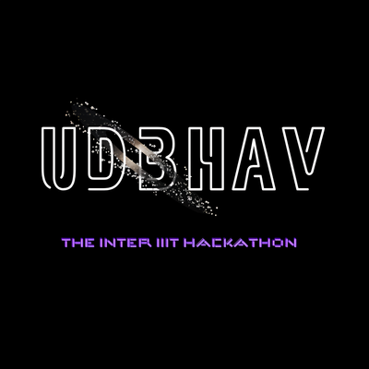
UDBHAV ROUND 2
ONLINE ROUND
  TEAM NAME :
  IIIT :
  PROBLEM STAETEMENT NUMBER:
  DOMAIN :
1

Slide 2
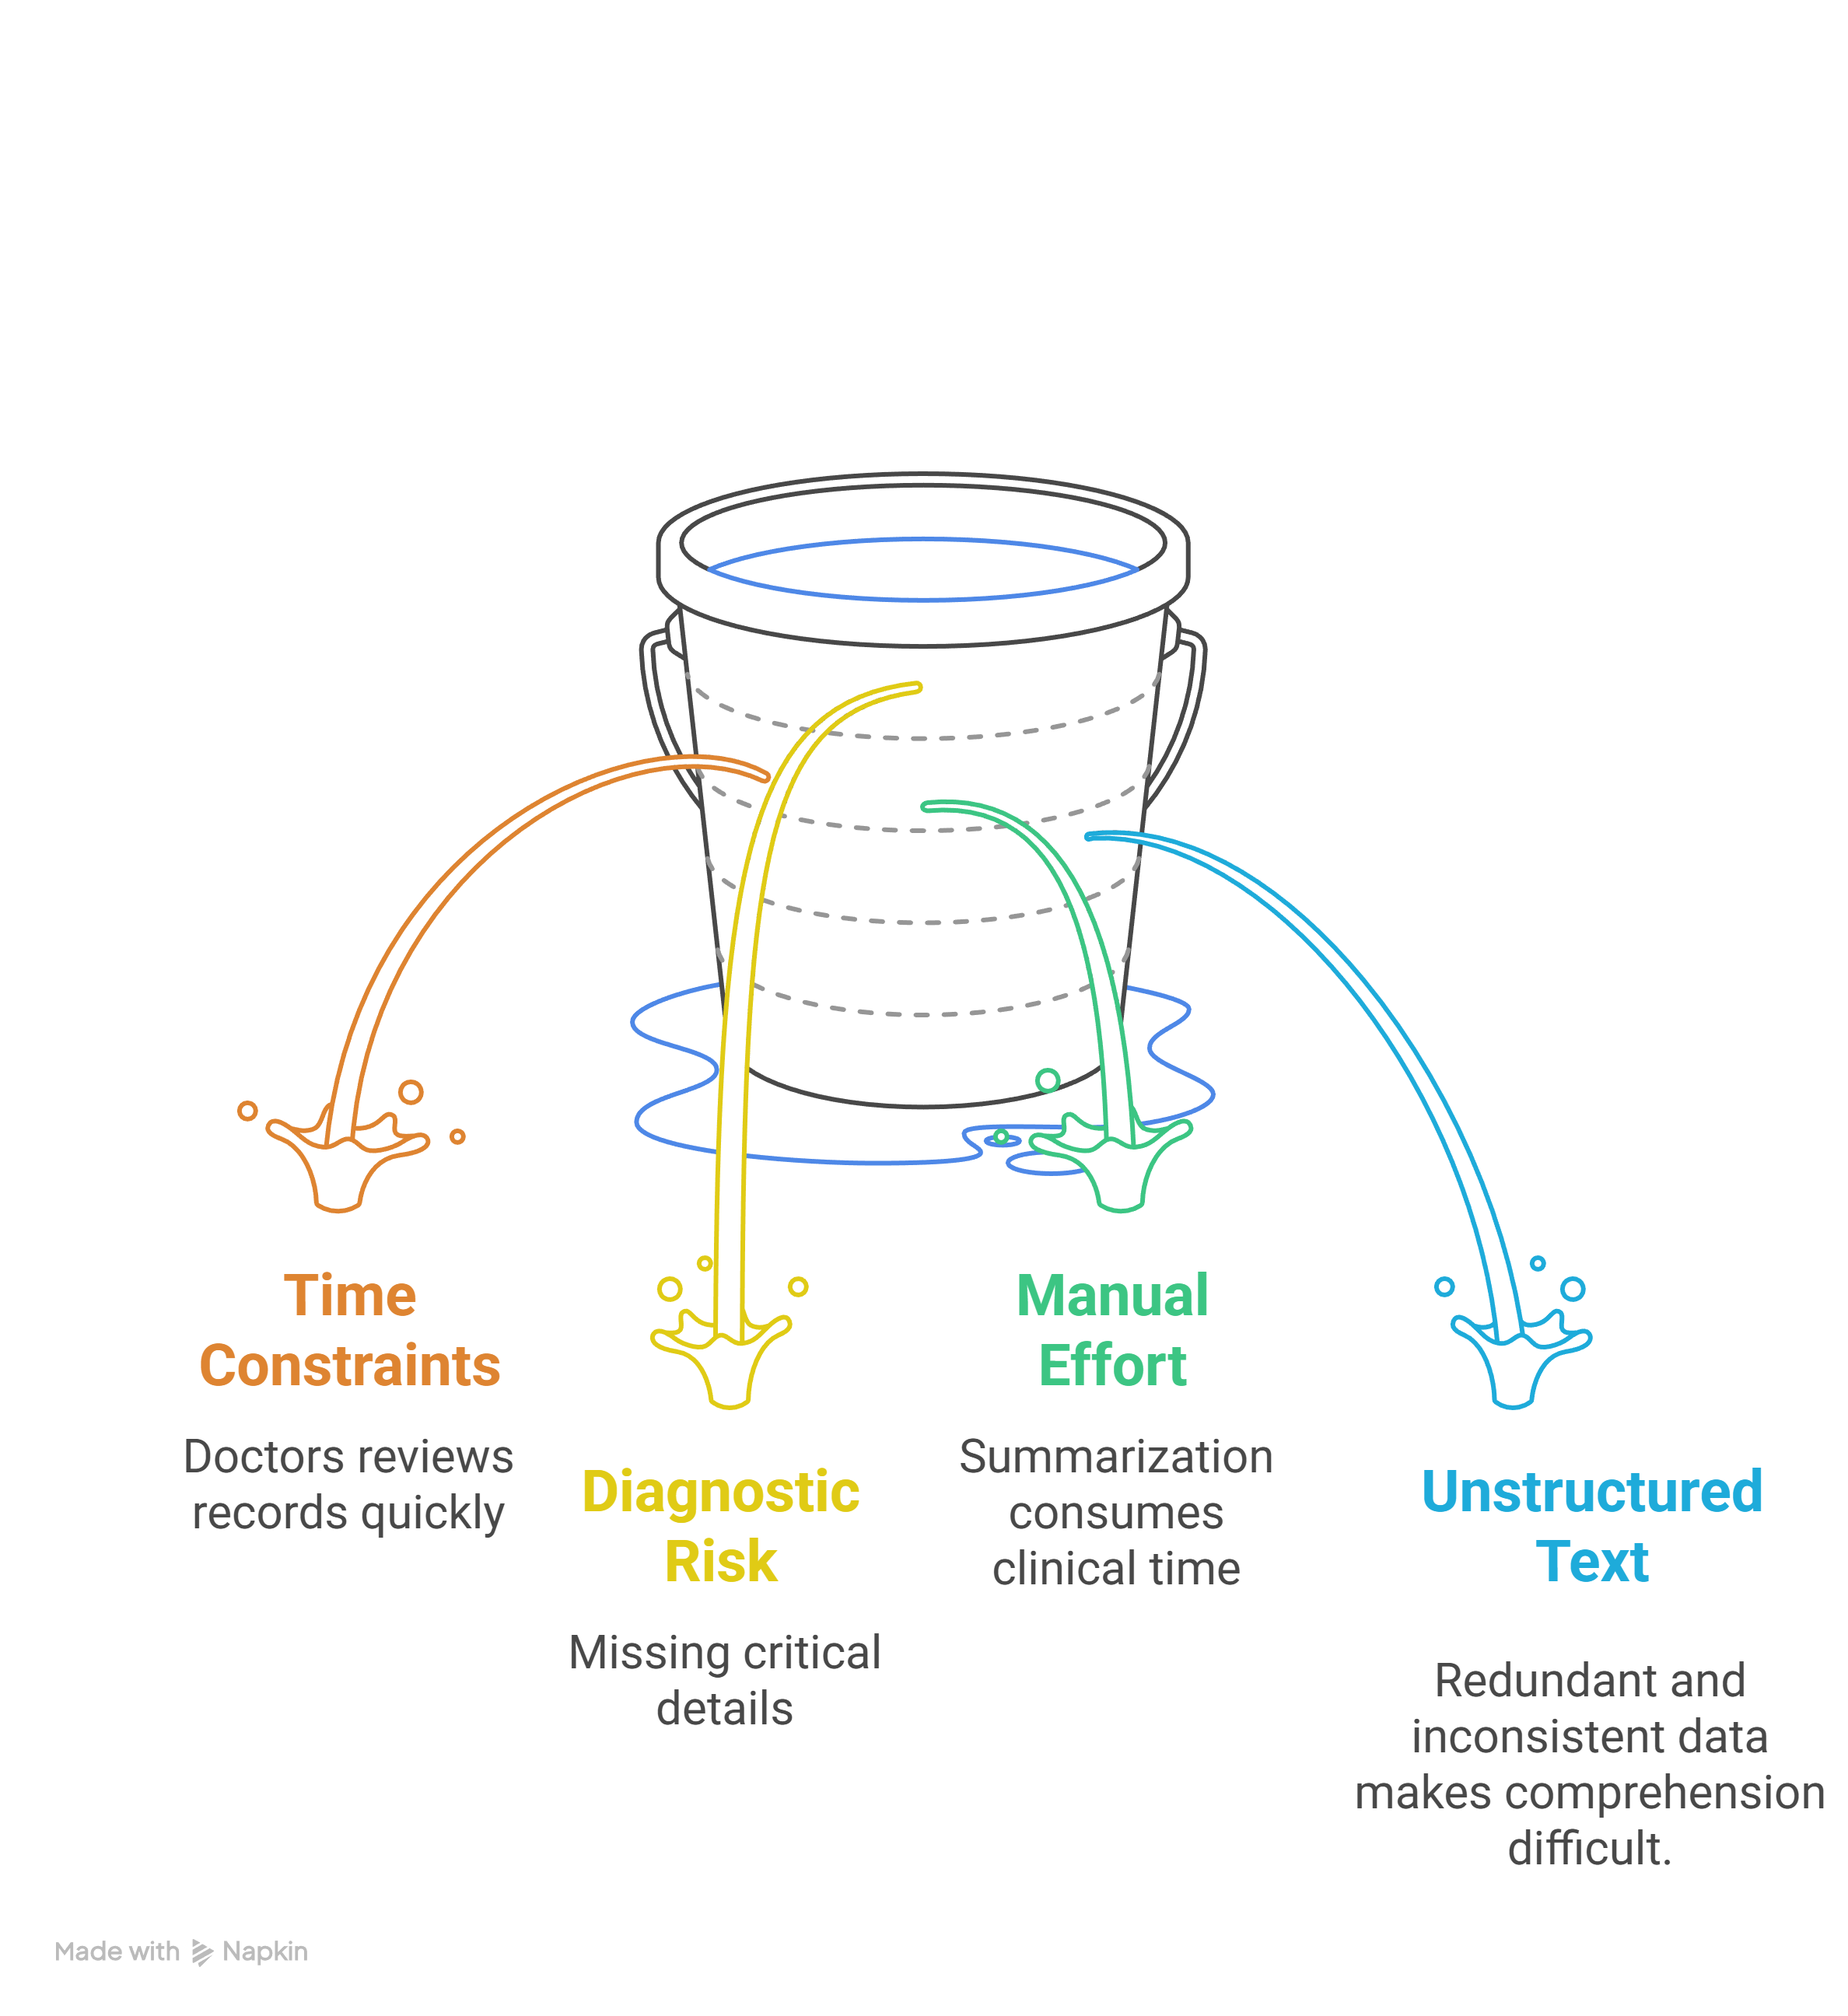
PROBLEM STATEMANT AND APPROACH
Clinicians handle large volumes of unstructured clinical notes (progress notes, reports, summaries).
80% of healthcare data is unstructured (clinical notes, reports, text).
Clinicians spend 20–100 minutes daily writing and 7–50 minutes reading notes.
Some doctors spend 2 extra hours on documentation for every hour of patient care.
59% of patient-reported note errors relate to the diagnostic process.
2

Slide 3
Data Ingestion & Pre-Processing
Input: Unstructured EHRs (from the MIMIC-IV dataset).
Named Entity Recognition (NER)
De-identification: Remove/replace PHI with placeholders.
Normalization & Tagging: Clean text, expand abbreviations, detect headers and tables.
Text Splitting: Clinical-aware and structure-aware chunking (~256 words, 20% overlap)
Embedding & Vector Store
Output
Before embedding, NER models identify and tag key medical entities (diseases, medications, symptoms, procedures, etc.).
These tags enhance semantic representation and improve retrieval relevance in the later stages.
Retrieval & Query Handling
Each processed chunk (with NER tags) is converted into dense embeddings using a biomedical embedding model (e.g., BioClinicalBERT).
Stored in a vector database (FAISS / Pinecone) for efficient semantic retrieval.
Prompt Construction
Based on the query (Resident ID, date, or clinical question), the retriever fetches top-relevant note segments from the vector store.
These retrieved segments form the context for the LLM.
LLM Processing (LLAMA-3)
The model generates:
Structured patient summary
Identified risk factors
Prioritized differential diagnoses - each linked to supporting text for traceability.
Produces a structured, explainable summary table including demographics, history, risk factors, and diagnosis list with evidence citations.
3

Slide 4
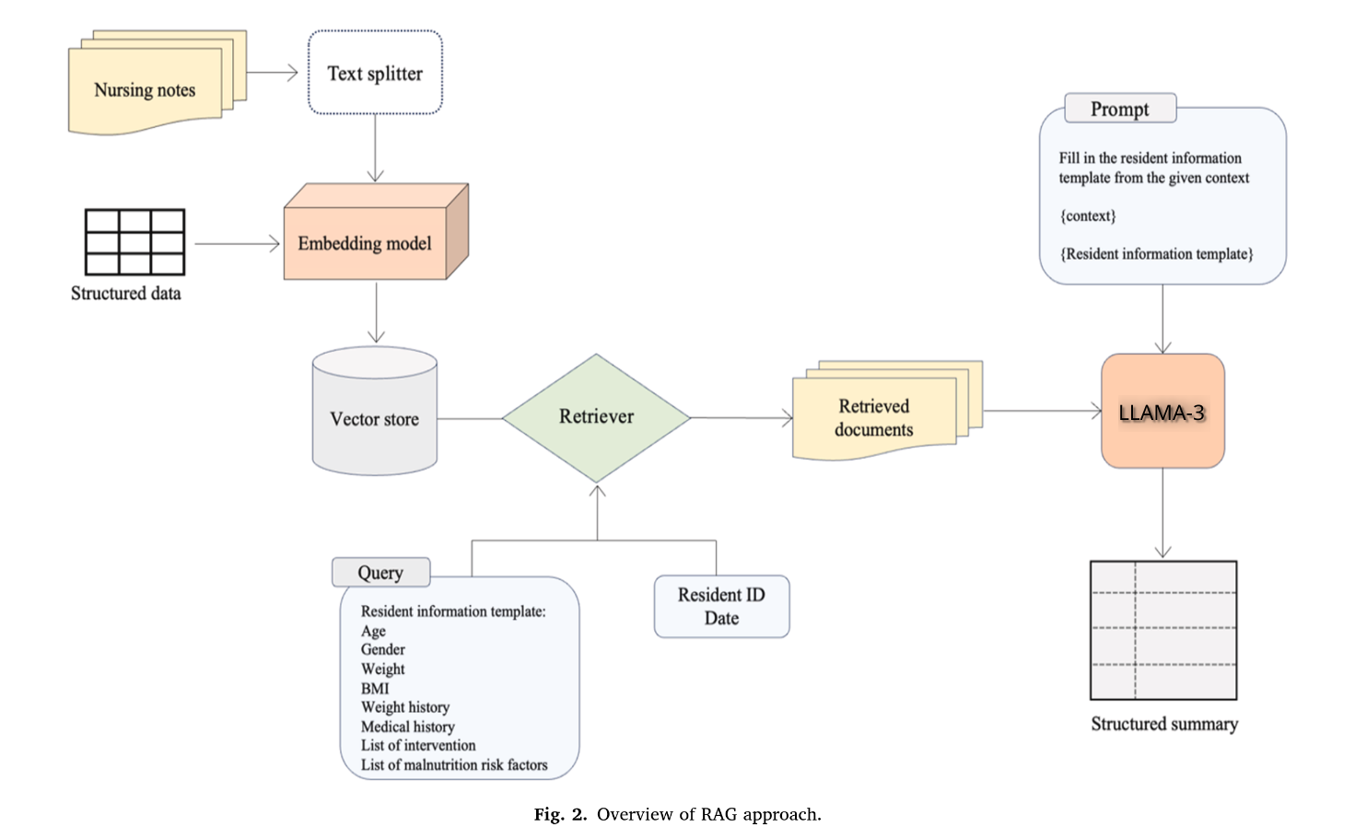
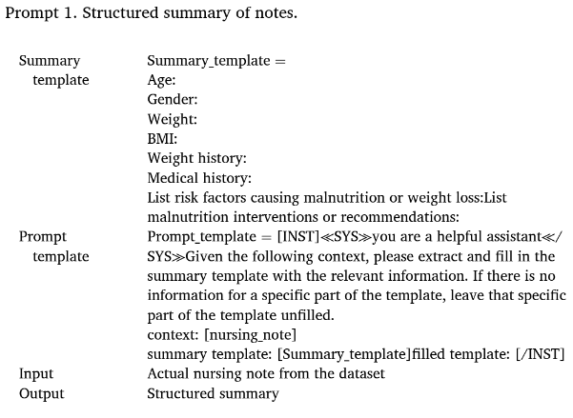
4

Slide 5
FEASIBILITY
Technical Feasibility
Economic Feasibility
Operational Feasibility
Uses publicly available medical datasets (like MIMIC-IV, i2b2) — no data licensing issues.
Employs open-source LLMs and biomedical embeddings (e.g., LLaMA-3, BioClinicalBERT).
Name Entity Recognition (NER) ensures accurate data structuring before embedding.
Fully local deployment — the model can be stored and run offline, without cloud dependency.
No recurring cloud cost — runs on local hardware, making it affordable and sustainable.
Open-source components reduce development and maintenance expenses.
Saves clinicians’ time, improving cost-to-efficiency ratio in healthcare settings.
Works seamlessly even in low-connectivity or rural areas — ideal for village hospitals and clinics.
Easy integration into existing EHR systems or standalone use.
Outputs are explainable and traceable, ensuring clinical trust.
5

Slide 6
IMPACT
For Clinicians
For Patients
For Healthcare Systems
Reduced burnout and workload through automated summarization.
Faster, more accurate decisions with AI-highlighted key findings.
Less after-hours paperwork and improved work-life balance.
Improved safety and outcomes due to fewer diagnostic errors.
More transparent care - explainable summaries that patients can understand.
Better engagement in their treatment process.
Higher operational efficiency - scalable across departments.
Standardized documentation aiding compliance and analytics.
Lower costs from time savings and reduced administrative burden.
6

Slide 7
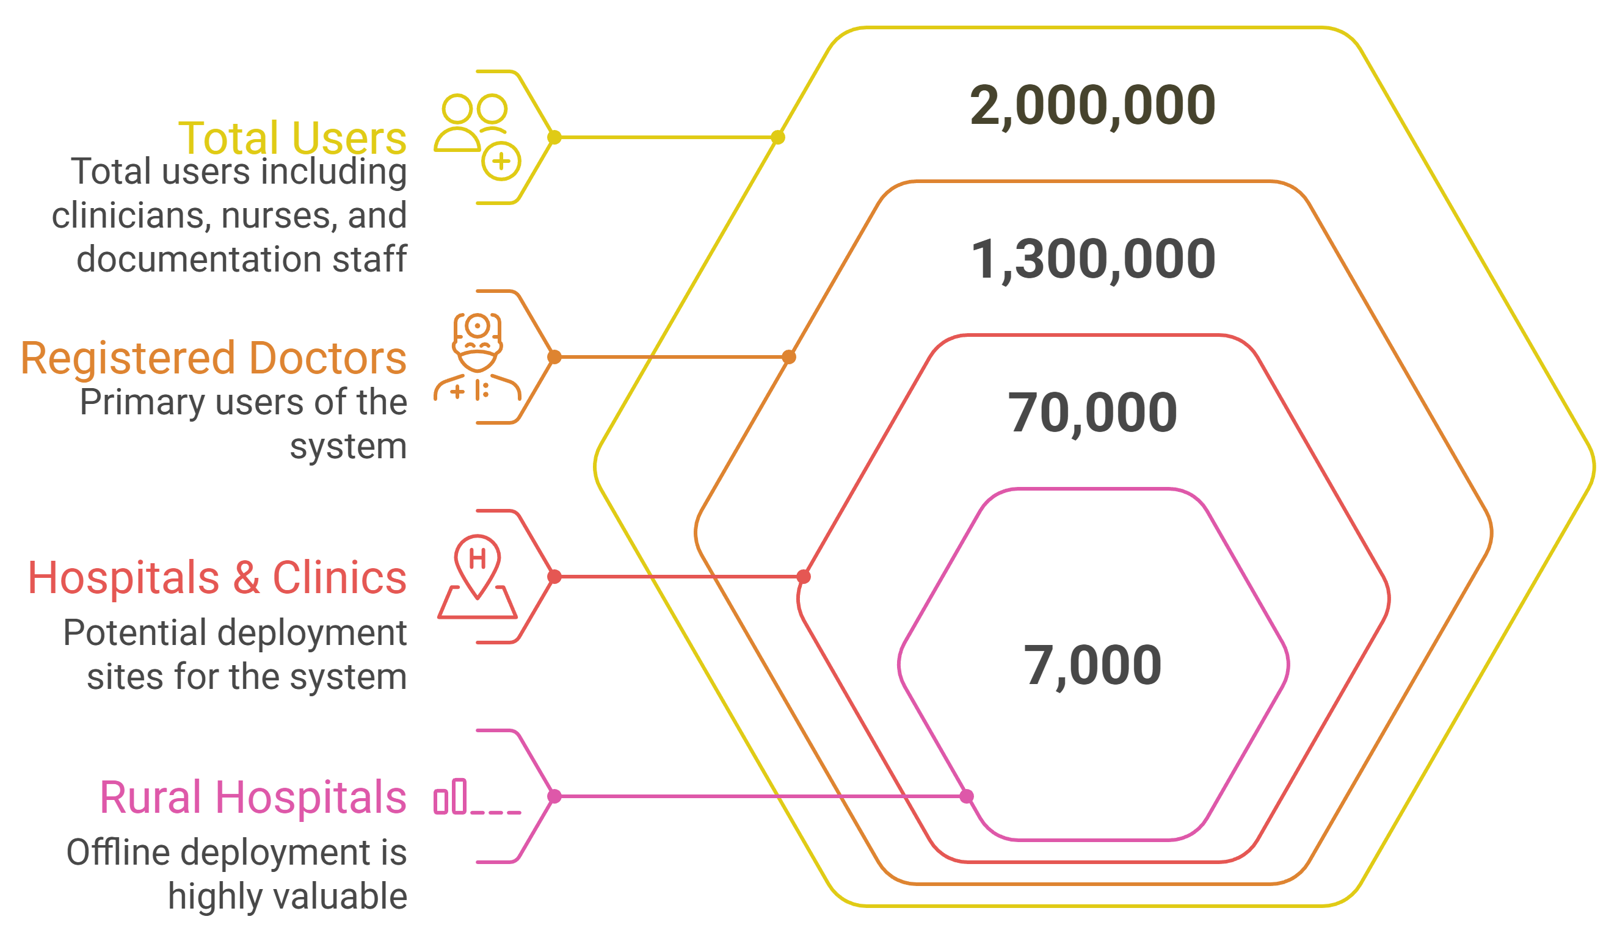
TARGET AUDIENCE
Primary Users (The Clinicians)
Physicians, PAs, & NPs: Need to reduce documentation time and get real-time diagnostic support (prioritized differential diagnoses) for faster, safer patient care.
Primary Buyers (The Organizations)
Hospitals & Health Systems: Aim to improve efficiency, combat physician burnout, and reduce diagnostic errors.
Secondary Audience
EHR Vendors: Integration partners.
Medical Trainees: Education and clinical reasoning development.
Coders/Payers: Streamline billing and claims review.
7

Slide 8
NOVELTY AND INNOVATION
Name Entity Recognition (NER) - Driven Enhancement
Added Name Entity Recognition (NER) before embedding using a fine-tuned BERT model (i2b2 dataset).
Extracts key entities (symptoms, diagnoses, labs) to enhance retrieval accuracy.
Indexes entities with embeddings - improves precision and reduces token load.
Inference time reduced: 20 s to 4 s; token length reduced: 6 k to 1-2 k.
Smarter Data Embedding
Unstructured data: Embedded using all-MiniLM-L6-v2 transformer.
Structured data: Converted to short canonical sentences before embedding.
Vectors (384-1024 dim) stored in ChromaDB for fast, scalable retrieval.
Uses top-k (k=5) similarity search for context precision.
8

Slide 9
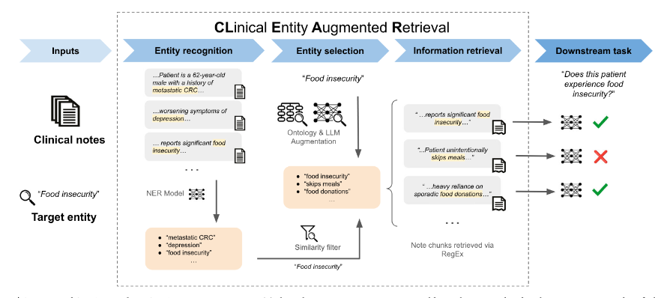
Name Entity Recognition (NER)
9

Slide 10
Query & Prompt Intelligence
Three custom templates for:
  Patient summarization
  Risk factor extraction
  Diagnosis generation
Ensures concise, consistent, and explainable outputs.
Why It’s Innovative
First pipeline to merge Clinical NER + RAG + Prompt Templates.
Delivers faster, lighter, and explainable GenAI outputs.
Fully offline, ideal for low-network or rural deployments.
Diverse & Explainable Retrieval
MMR-based retrieval ensures diversity of retrieved chunks.
Combines retrieved text + prompts gives rich context for LLM inference.
Outputs:
  Structured patient summary
  Differential diagnoses with traceable evidence from input notes.
10

Slide 11
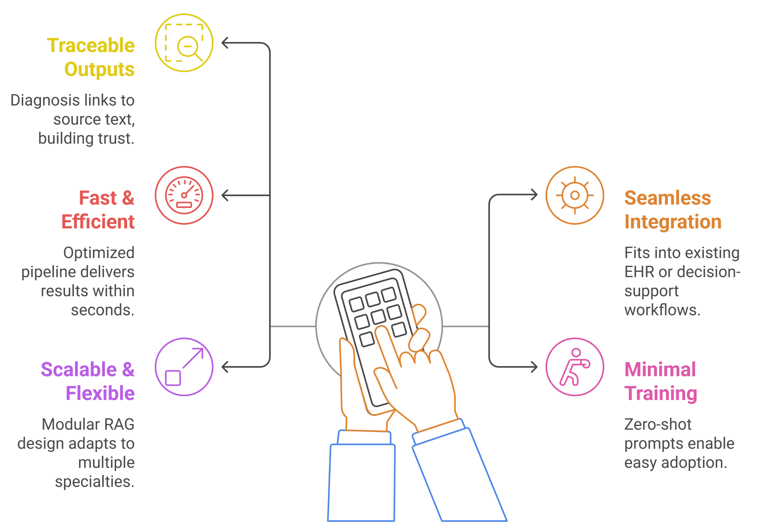
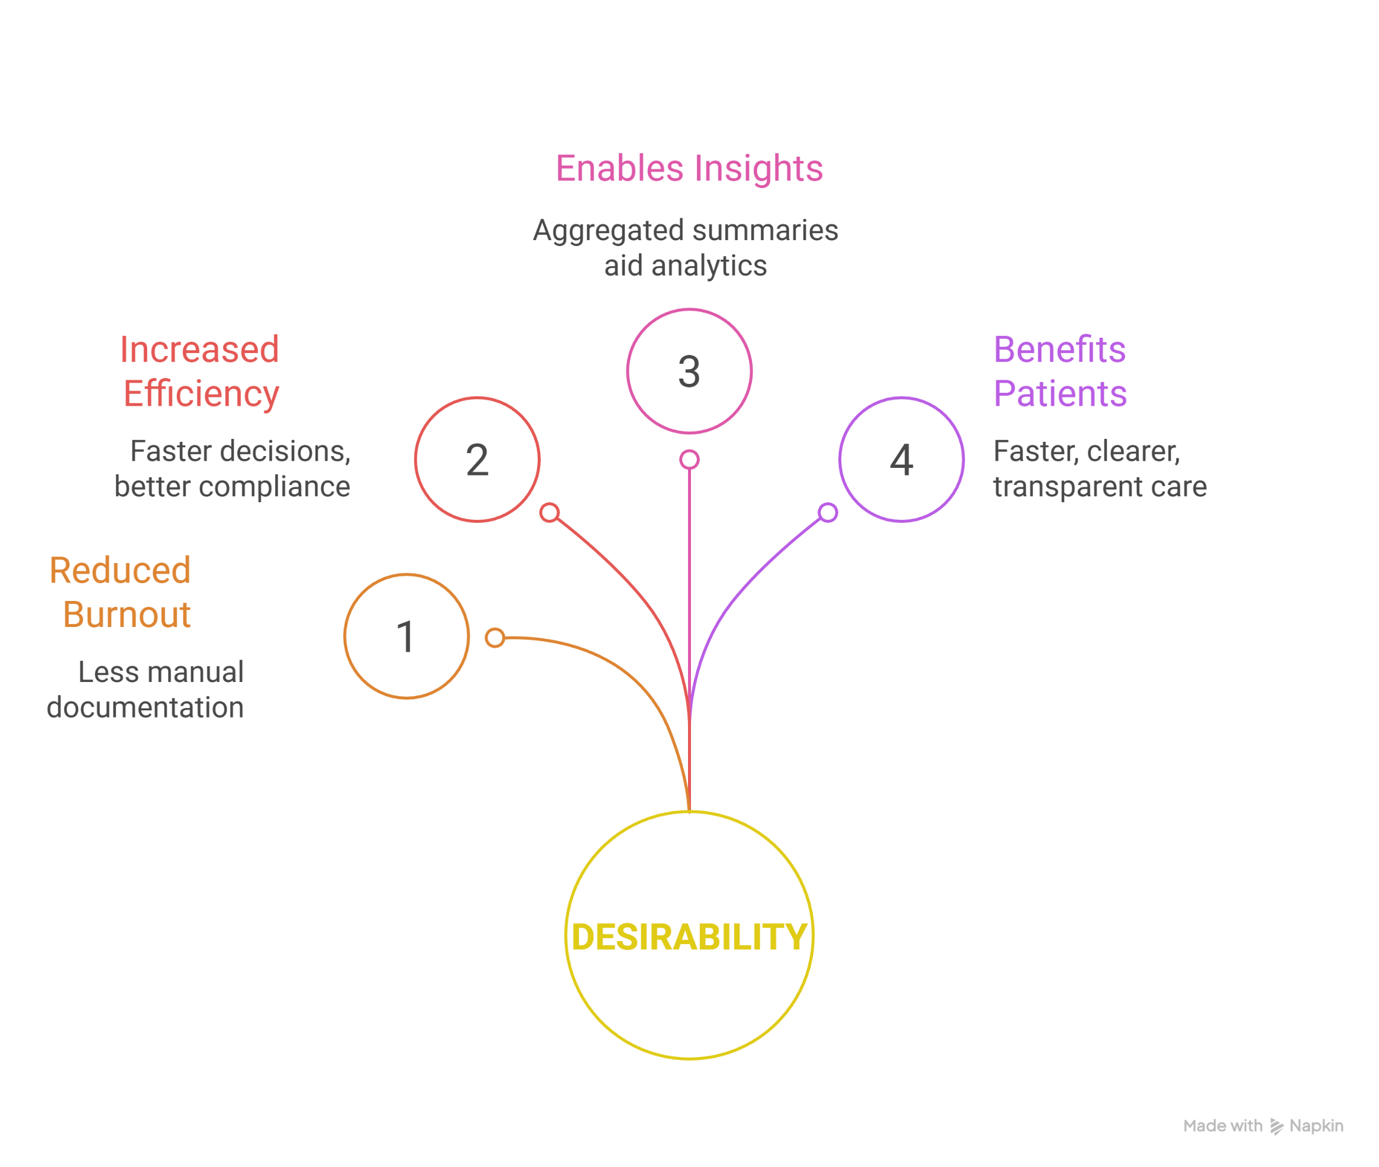
USABILITY AND DESIRABILITY
USABILITY
DESIRABILITY
7

Slide 12
TEAM MEMBERS WORK DISTRIBUTION
PRANJAL MISHRA
Data Structure Study and Presentation
PIYUSH GUPTA
ML Flow and Architecture Design
8

Slide 13
Thank You
9

